Slide 1
Soils
Chapter
14
Learning outcomes: 1.4., 2.4

Slide 2
At the end of this chapter, you will be able to:
14.1 Describe the composition of soil.
14.2 Assess your soil type.
14.3 Explain how soil is formed.
14.4 Describe contrasting soils in Ireland soil.
14.5 Explain how soil and vegetation are interconnected.
14.6 Describe the exploitation of soil as a natural resource.

Slide 3
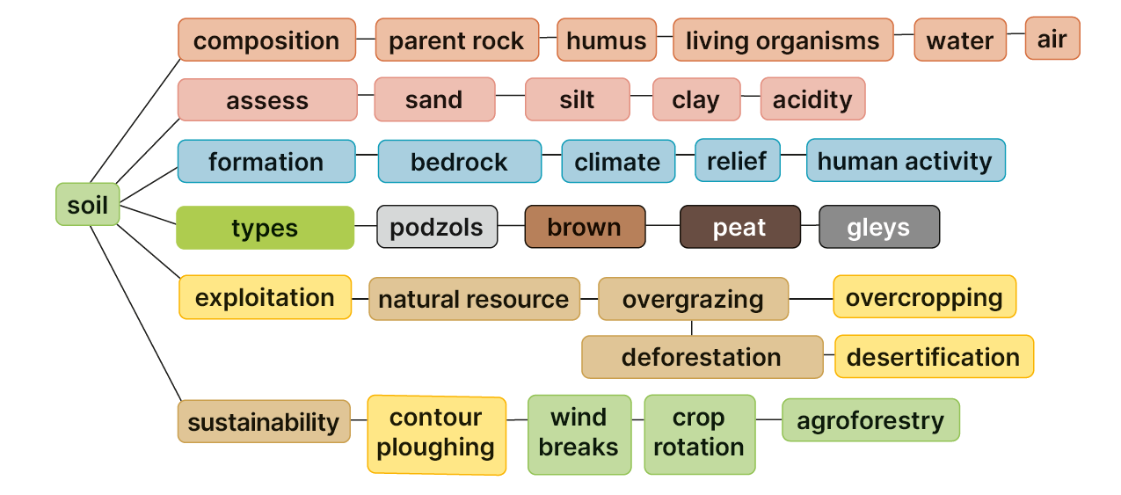
Keyword connections

Slide 4
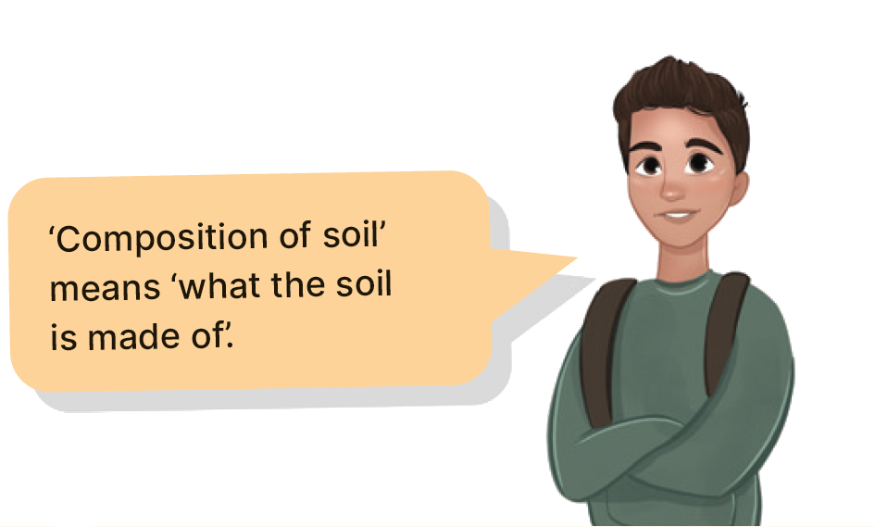
14.1 Describe the composition of soil.
Mineral matter
Humus
Air
Water
Living organisms

Slide 5
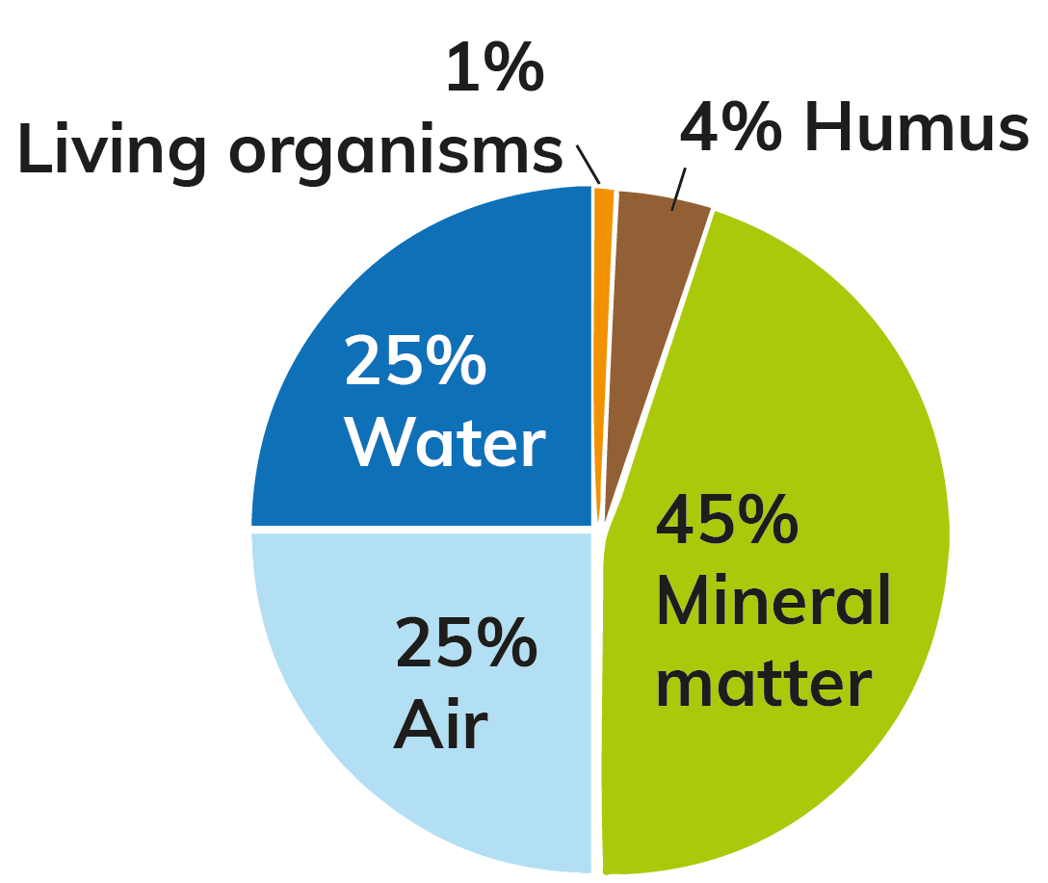
14.1 Describe the composition of soil.
Mineral matter
Mineral matter is the largest component of soil.
It comes from bedrock that has been broken down by the processes of weathering and erosion.
This material includes stones, sand, clay and silt. These are important, as they help nourish plants that grow in the soil.

Slide 6
14.1 Describe the composition of soil.
Humus
Humus is a dark, jelly-like substance that is rich in nutrients.
It forms when dead plants and leaves decay on top of the soil.
This process is called humification.
Living organisms then mix this material through the soil.
Humus helps bind soil together and increases the fertility of soil.

Slide 7
14.1 Describe the composition of soil.
Air
Air is found in the spaces between soil particles.
It is essential for plant growth, as it supplies oxygen and nitrogen.
It also enables living organisms to survive in soil.

Slide 8
14.1 Describe the composition of soil.
Water
Water is an important component of soil, as it helps plants to grow.
Water dissolves the minerals and nutrients in the soil, which allows plants to absorb them through their roots.

Slide 9
14.1 Describe the composition of soil.
Living organisms
Earthworms and insects live in soil.
They burrow through the soil, allowing water and air to pass through.
This burrowing action helps to mix the soil. Microorganisms such as bacteria and fungi also live in soil.
They help to break down dead plants to form humus.
This increases soil fertility.

Slide 10
14.1 Describe the composition of soil.
Go to Section 14.1 on page 75 of your Skills Book.

Slide 11
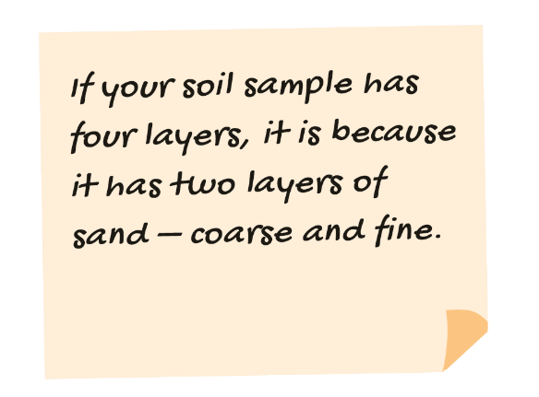
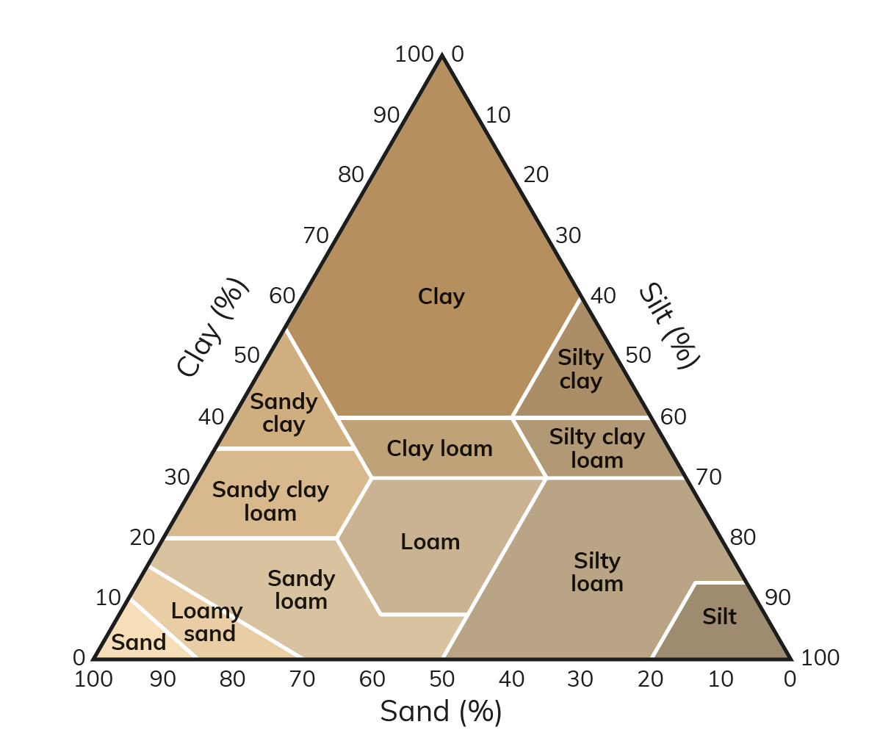
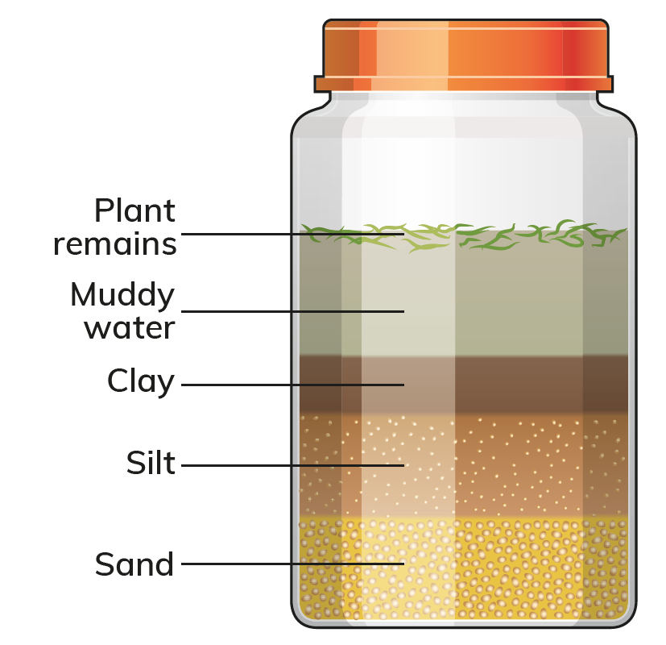
14.2 Assess your soil type.

Slide 12
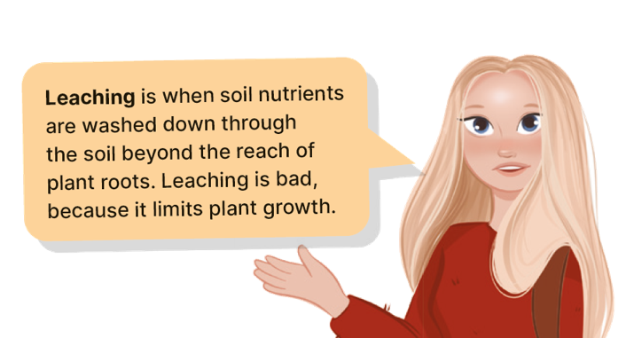
14.2 Assess your soil type.
Soil texture
Clay
Clay particles are the smallest, at less than 0.002 mm in diameter! The small particle size makes clay stick together. This results in a heavy, usually sticky soil.
Clay soils are difficult to plough, so they are usually used for dairy farming.
If the water in your jar is still muddy after a day, it is because clay particles are suspended in the water.
Silt
Silt particles are smaller than sand but bigger than clay.
These drain well but can get waterlogged during heavy rainfall.
A soil that is mostly sand and silt will be good for farming.
Sand
Sand particles are larger – this is why they settled first in your jar. The sand allows water to drain freely from the soil, so it is good for farming. If there is too much sand, however, leaching may occur, or the soil may dry out in summer.

Slide 13
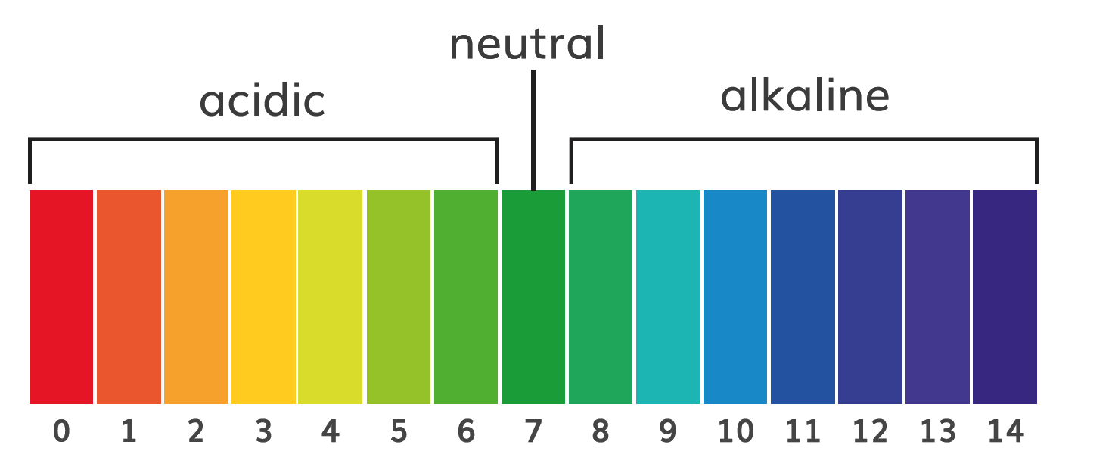
14.2 Assess your soil type.
Soil acidity
How acidic a soil is affects which plants grow well in a soil. A soil may be acid or alkaline (basic).
Soil acidity is measured on the pH scale. The pH scale runs from 0 (most acid) to 14 (most alkaline).
Follow the instructions on page 168 of your Textbook to test the acidity of your soil sample.
Plants grow well in soils with a pH of 6.5.
If a soil is too basic (pH greater than 8), it may need fertiliser added to it to make it more suitable for planting crops.
Soils that are too acid (pH lower than 6) may need to have lime added to them.
Lime is made from limestone and is alkaline. Alkalines neutralise acids.

Slide 14
14.2 Assess your soil type.
Go to Section 14.2 on page 75 of your Skills Book.

Slide 15
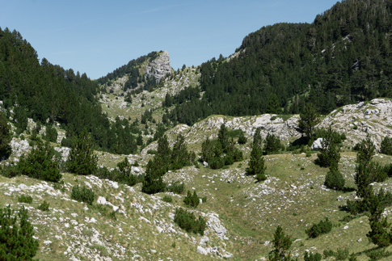
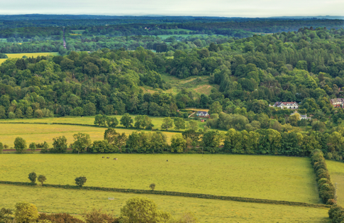
14.3 How Soil is Formed
Bedrock
Bedrock is broken down by weathering.
It provides the mineral matter for the soil.
Some rocks weather slowly (e.g. granite), whereas others break down quickly (e.g. limestone).
This means that it takes longer for soil to form in a granite area.
The type of rock also affects the characteristics of the soil.
For example, soils that develop in limestone areas are rich in nutrients.
Relief
Relief is the shape of the land – upland or lowland.
Highland areas are wetter, so there is more water in the soil. This can lead to leaching or to soil becoming waterlogged.
There is less plant life in highland areas because of the harsh climate.
This means there is less humus.
Lowland areas tend to have deeper, well-drained soils. This means that the soil is more fertile.

Slide 16
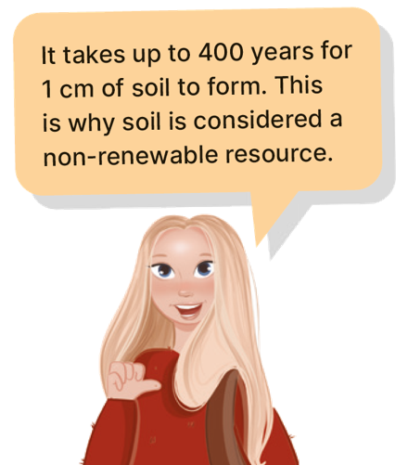
14.3 How Soil is Formed
Climate
Rainfall and temperature determine the rate at which the parent rock is broken down by weathering and erosion.
In cold areas, freeze-thaw action slowly breaks down rock. This results in thin soils developing.
In hot areas, chemical weathering breaks down material rapidly to form deep soils.
In wet areas, leaching washes minerals and nutrients deep into soils, causing them to become infertile.
In dry areas, soils can become so dry and hard that rain, when it falls, cannot soak into them.
Human activity
Human activity affects the composition and quality of soil.
Ploughing, irrigation schemes and the use of fertilisers can make soil more fertile.
The removal of vegetation and the overuse of soil can strip it of nutrients and make it less fertile. This can also lead to soil erosion.

Slide 17

14.3 How Soil is Formed
1. What is humus?
2. What processes form the mineral matter of soil?
3. Why is soil acidity important?
4. How long does it take for soil to form?
5. Why are living organisms important for soil?

Slide 18
14.3 How Soil is Formed
Higher-order questions 1
1. What happens to soil if you remove all the water from it? What are you left with?
2. When you assess your soil, was it different to any of your classmates’ soils? If so, how? Can you explain why?
3. How do surface processes such as mass movement, river and glacial processes affect soil?

Slide 19
14.3 How Soil is Formed
Go to Section 14.3 on page 76 of your Skills Book.

Slide 20
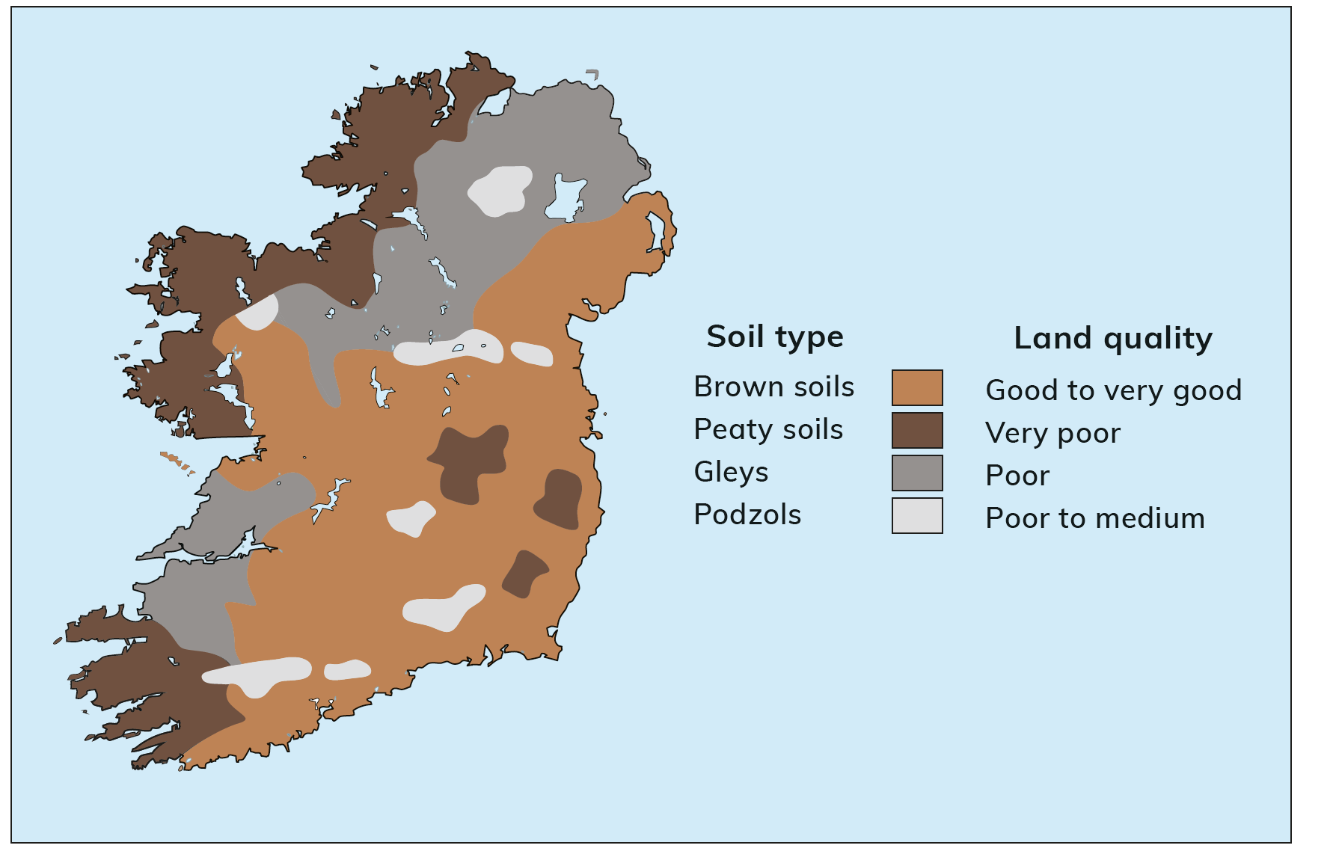
14.4 Describe contrasting soils in Ireland.
Ireland has four main soil types:
Peat soil (found in bogs)
Gley (a heavy waterlogged soil)
Brown earths
Podzols

Slide 21
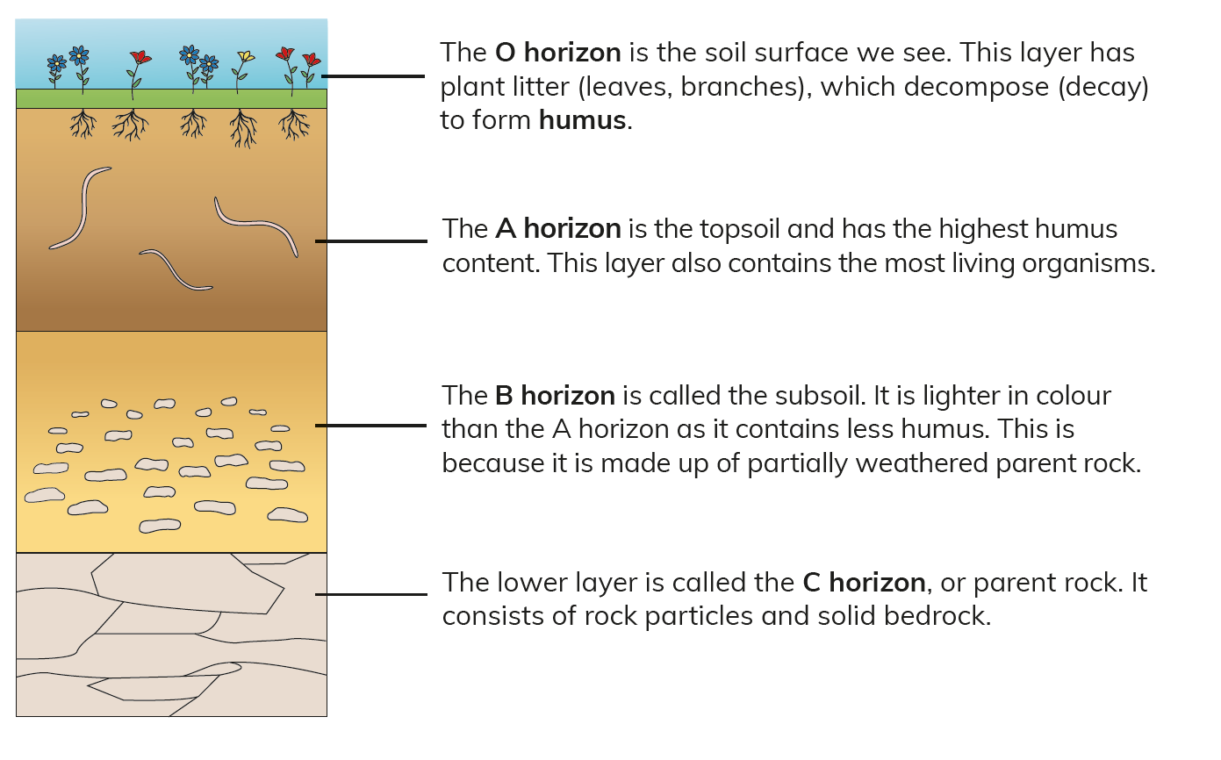
14.4 Describe contrasting soils in Ireland.
Soil Profiles
A soil profile is a cross-section down through a soil.
It shows the layers that make up the soil.
These layers are called horizons.

Slide 22
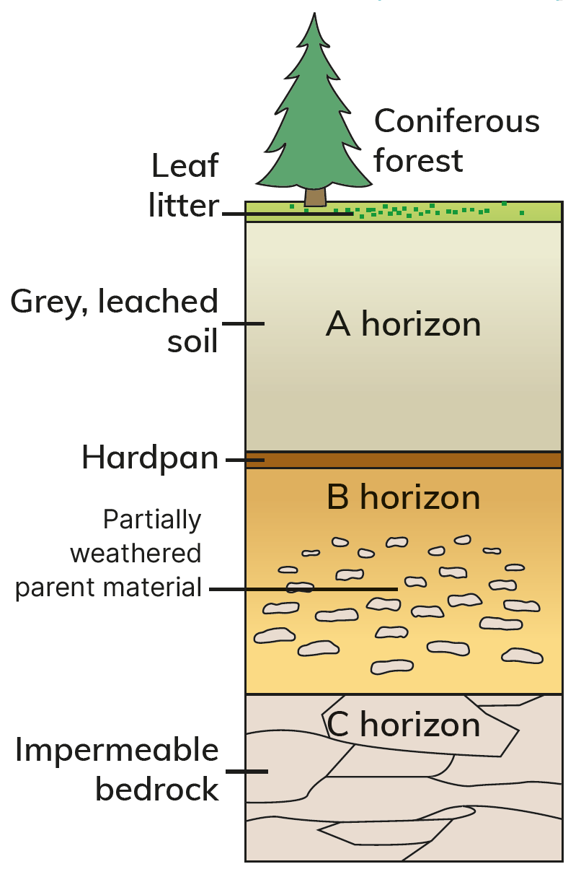
14.4 Describe contrasting soils in Ireland.
Soil type |  | Podzol
Colour |  | Grey
Formed in |  | Areas that were once covered by coniferous forests Cold, wet, upland areas Wexford, Cork and Galway
Soil processes |  | Limited leaf litter Excessive rainfall causes leaching; nutrients are washed through the A horizon; plant roots cannot reach the nutrients Leaching also forms a hard, impermeable layer of nutrients, called hardpan; this makes the soil waterlogged – water cannot drain out of the soil
Uses |  | Infertile soil and slightly acidic Only suitable for forestry or rough grazing of sheep or goats

Slide 23
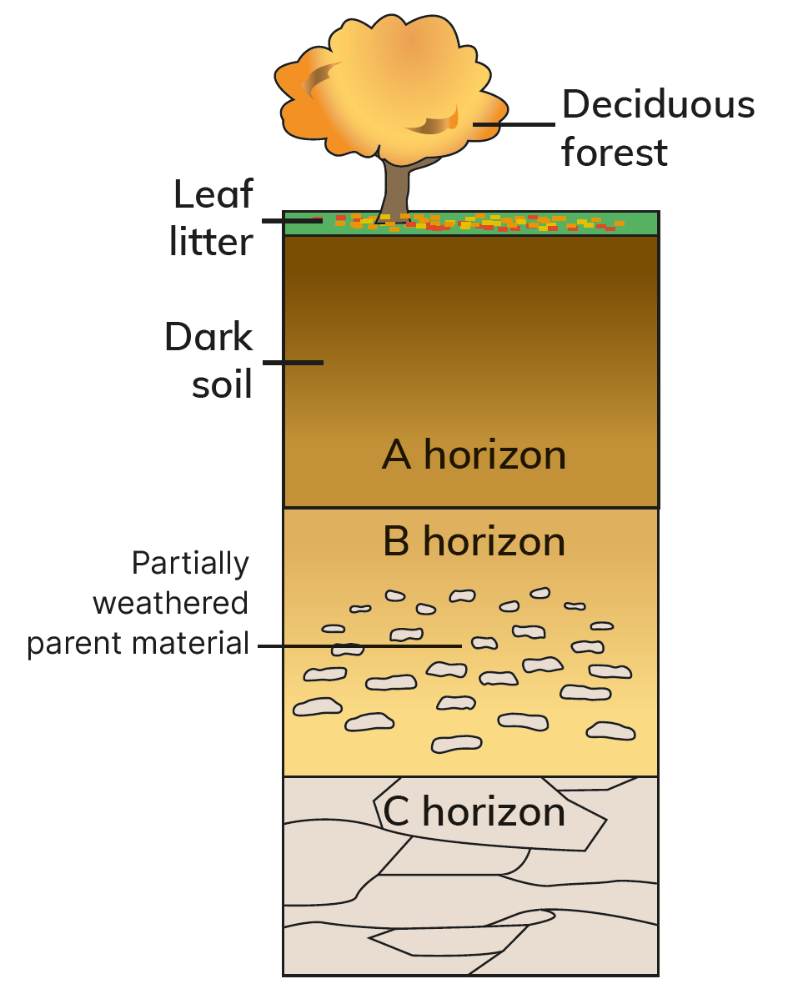
14.4 Describe contrasting soils in Ireland.
Soil type |  | Brown Soils
Colour |  | Dark brown
Formed in |  | Areas once covered in deciduous trees Ireland’s most common soil Midlands, south, east of Ireland
Soil processes |  | Humification of plentiful supply of plant litter Rich humus and moderate rainfall supply the soil with nutrients
Uses |  | Fertile, well-drained soil Good for arable or pastoral farming

Slide 24
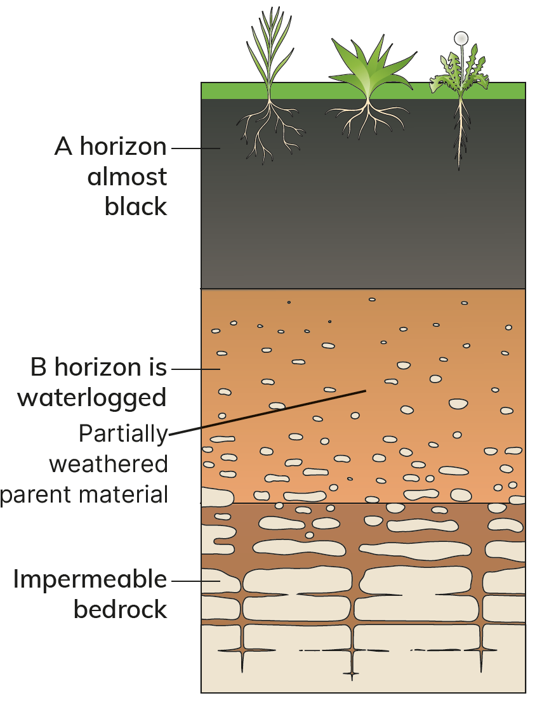
14.4 Describe contrasting soils in Ireland.
Soil type |  | Peat soils
Colour |  | Black
Formed in |  | Limited plant litter available Cold, wet, upland areas and lowland hollows Mountain locations and in the midlands
Soil processes |  | Limited leaf litter High levels of rainfall lead to waterlogging Humus doesn’t decay fully Leaching occurs
Uses |  | Infertile soil Only suitable for coniferous forestry or rough grazing of sheep

Slide 25
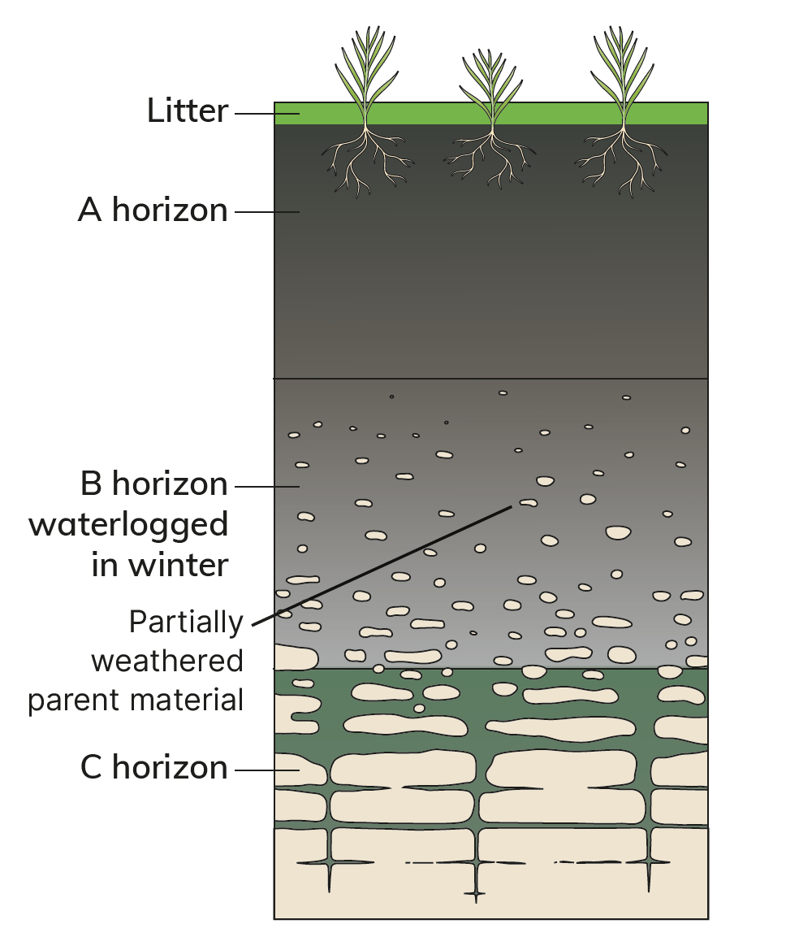
14.4 Describe contrasting soils in Ireland.
Soil type |  | Gleys
Colour |  | Blue-grey
Formed in |  | Cold regions with high rainfall Impermeable bedrock or high percentage of clay Ulster, north midlands, Clare, Limerick
Soil processes |  | Poorly drained Waterlogging occurs Poor humus
Uses |  | Infertile soil Only suitable for grazing of sheep

Slide 26
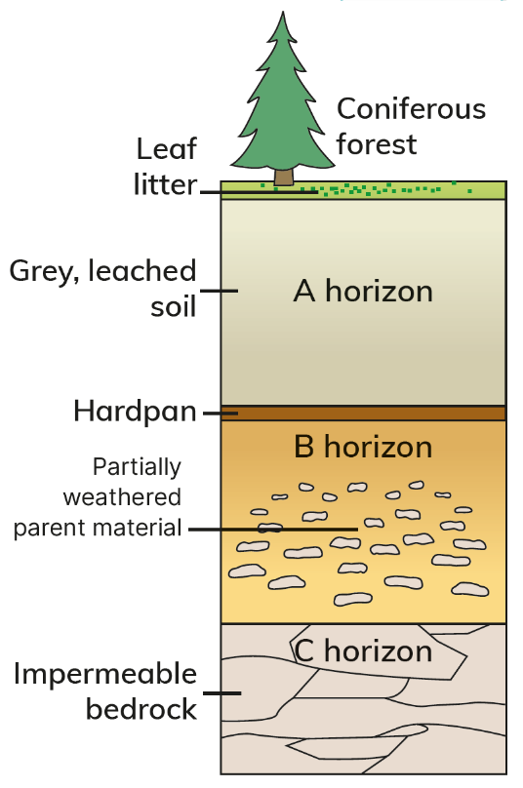
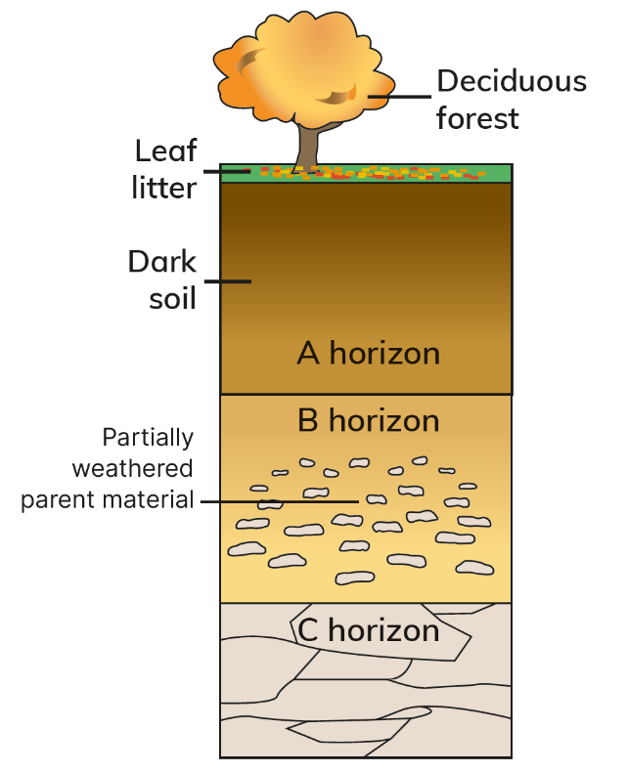
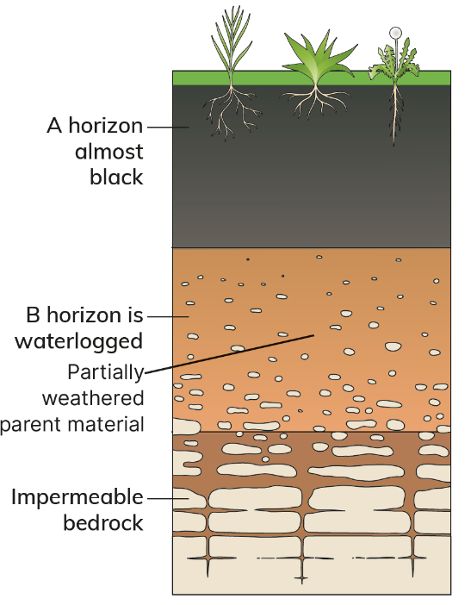
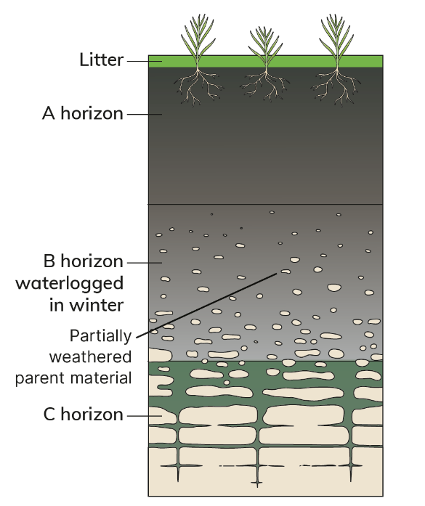
14.4 Describe contrasting soils in Ireland.
Podzol
Brown soil
Peat soil
Gleys

Slide 27

14.4 Describe contrasting soils in Ireland.
1. List the four main soil types in Ireland.
2. What is a soil profile?
3. What is the most common soil in Ireland?
4. What is leaching?
5. Why is drainage important for soils?

Slide 28
14.4 Describe contrasting soils in Ireland.
Higher-order questions 2
1. It takes approximately 400 years for 1 cm of soil to form. Is it possible to manufacture (make) soil? How would you do this? Would it be worthwhile?
2. Look at the map of soils in Figure 14.8 on page 170 of your Textbook. Why are most of the peaty soils located along the west coast of Ireland?
3. If we planted deciduous trees on podzols, would this improve podzols and make them more fertile?

Slide 29
14.4 Describe contrasting soils in Ireland.
Go to Section 14.4 on page 76 of your Skills Book.

Slide 30
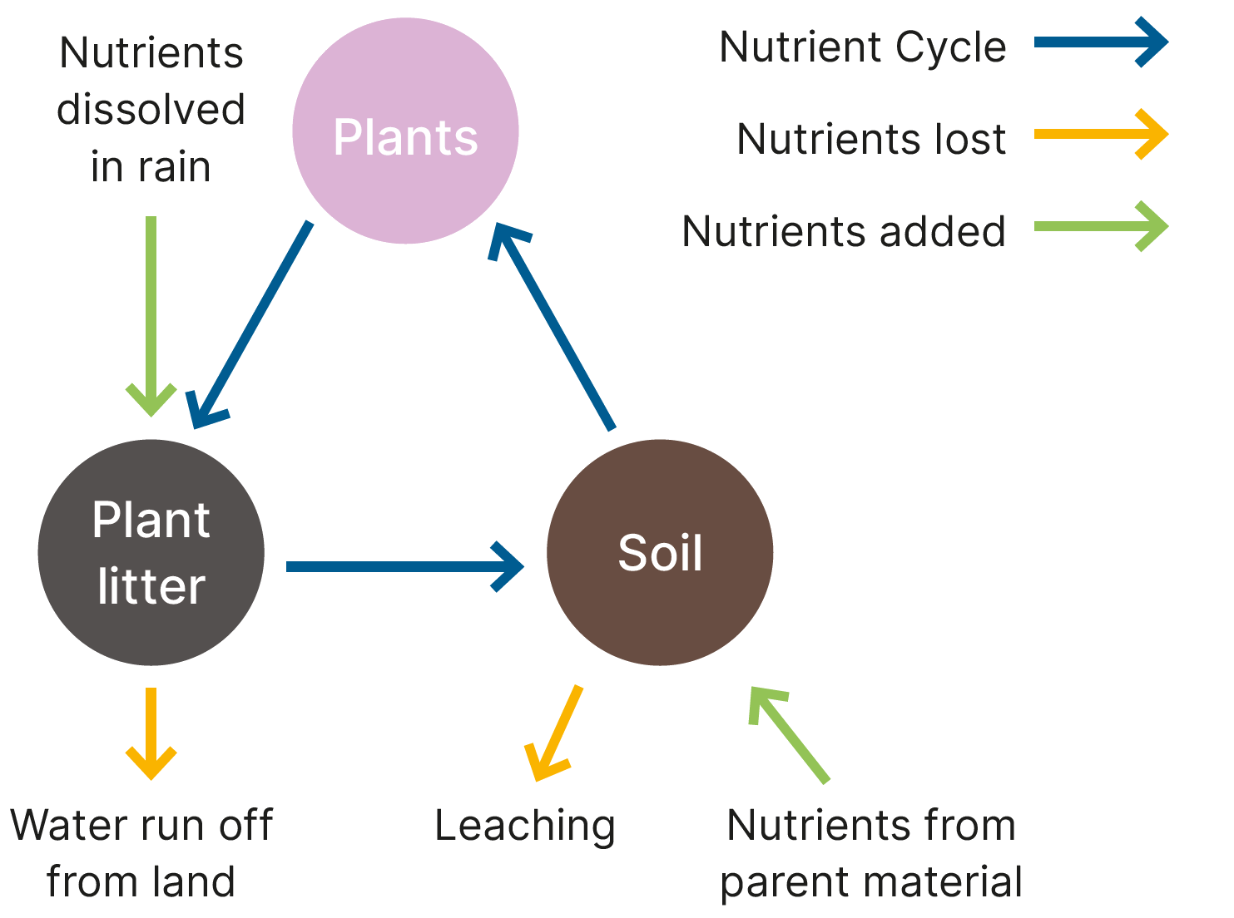
14.5 Explain how soil and vegetation are interconnected.
Soil forms part of an ecosystem or biome.
An ecosystem is an area where plants, animals and other organisms interact with the physical landscape and climate.
Soil and plants interact in an ecosystem as part of the Nutrient Cycle.
The Nutrient Cycle describes how nutrients move between soil and plants and back again. Nutrients are elements such as nitrogen, carbon and iron.

Slide 31
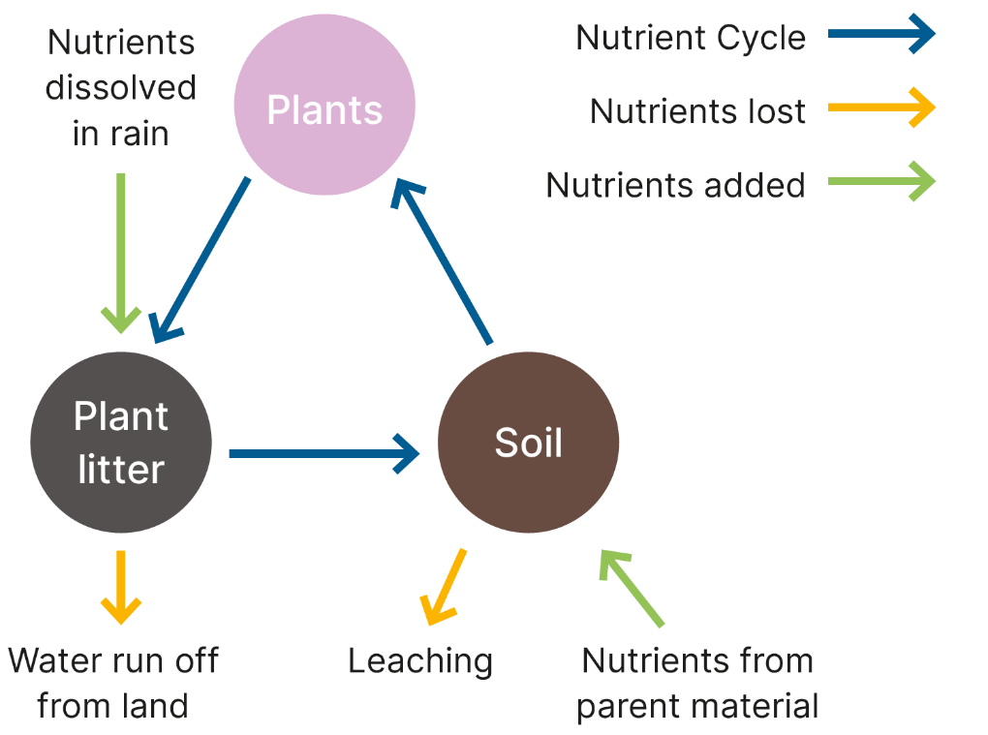
14.5 Explain how soil and vegetation are interconnected.
Nutrients enter the soil from the parent material and from the atmosphere.
Plants absorb nutrients from the soil. When leaves fall from plants, they decay to form humus. Nutrients from humus enter the soil and the cycle repeats itself.
If there is too much rainfall, leaching may happen. This stops plants from absorbing nutrients.
If nutrients are not available to plants, they cannot thrive and they cannot provide enough plant litter for a rich humus. The soil becomes infertile.
The Nutrient Cycle shows us that plants and soils are dependent on each other.

Slide 32
14.5 Explain how soil and vegetation are interconnected.
Go to Section 14.5 on page 78 of your Skills Book.

Slide 33

14.6 Describe the exploitation of soil as a natural resource.
A natural resource is material in nature that we can use to improve our life.
As a vital natural resource, soils:
Provide the foundation and nutrients for plant growth.
Plants provide the food humans and animals eat.
Plants also provide the fibres we use to make clothes.
Filter and store the water we drink.
Contain a quarter of the world’s biodiversity.
Act as a carbon store. Protecting soil helps combat climate change.
Provide resources used in making medicine, such as antibiotics.
If we protect and conserve soil, we can use it sustainably. This means we can use soil to meet our needs today and still have soil to allow future generations to meet their needs.

Slide 34

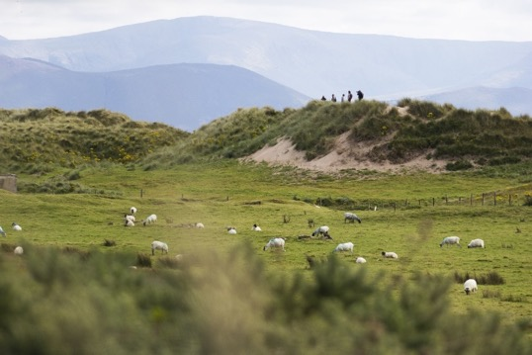
14.6 Describe the exploitation of soil as a natural resource.
1. Overgrazing is when too many animals graze in a limited space and remove the plant cover from soil.
This exposes the soil to wind and rain, which can remove the topsoil, causing soil erosion.
Impact of Overgrazing in Ireland
Ireland joined the EU in 1973.
The EU gave ﬁnancial support (money) to farmers with sheep.
This led to a huge increase in the number of sheep in Ireland.
In Mayo and Galway alone, there were 2 million sheep.
Up to 30 per cent of upland areas became at risk from overgrazing.
Overgrazing puts pressure on vegetation, particularly in upland areas.
Loss of vegetation can lead to soil erosion and mass movement
In 2003, up to 80 mm of rain fell in north Mayo over a two-hour period. More than 40 individual landslides and mudﬂows resulted.
Houses were cut off, roads were washed away and bridges were destroyed.

Slide 35
14.6 Describe the exploitation of soil as a natural resource.
2. Overcropping (over-farming)
When soil is farmed too heavily
If nutrients are not replaced, the soil can lose its fertility.
Once this happens, soil erosion can occur.
Monoculture – growing the same crop on the same land all of the time – can cause a loss of soil quality.
The soil uses up certain nutrients that need to be replaced by artificial fertilisers.
In developing countries (poorer countries), farmers may not be able to afford these fertilisers.
The soil becomes exhausted and soil erosion occurs.

Slide 36
14.6 Describe the exploitation of soil as a natural resource.
3. Deforestation
Deforestation is the cutting down of trees.
As the world’s population increases, the demand for wood and for food increases.
Illegal logging in Brazil has left soils exposed to the weather.
Poor farming methods have also caused soil to become exhausted.
This causes soil erosion.

Slide 37
14.6 Describe the exploitation of soil as a natural resource.
4. Climate change
Rapid change in the Earth’s climate as a result of burning fossil fuels
In some regions, climate change has caused increased rainfall.
This produces floods that can wash soil away, as happened in Germany in July 2021 (see page 124 of your Textbook).
Climate change will make some regions experience less rainfall.
This causes drought.
Drought causes desertification – the spread of a desert into previously fertile land, e.g. the Sahel in Africa.

Slide 38

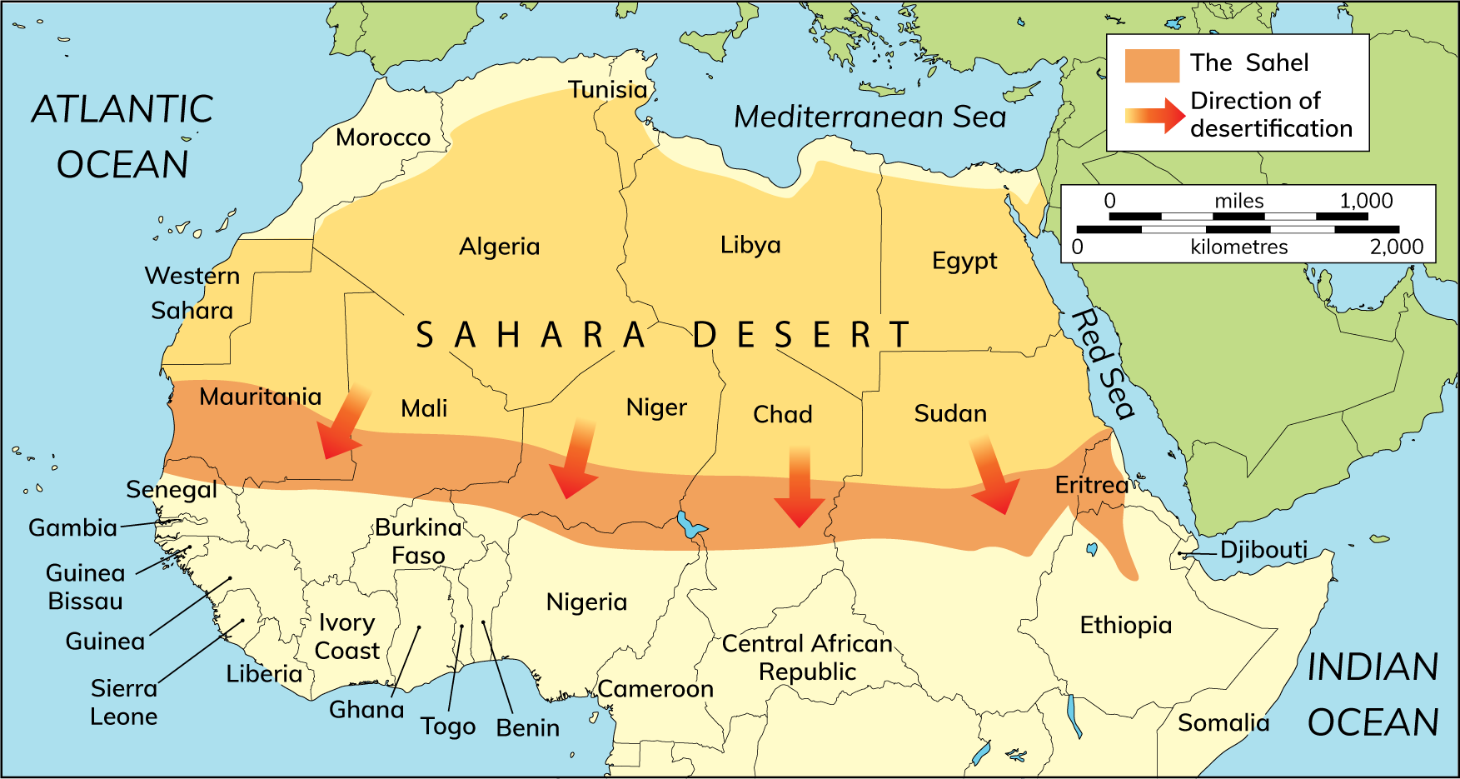
14.6 Describe the exploitation of soil as a natural resource.
Desertification in the Sahel
The Sahel is a semi-arid region just south of the Sahara Desert in Africa.
Much of the Sahel is experiencing desertiﬁcation.
Once sand blows onto fertile land, it destroys it, and the land can no longer be cultivated.

Slide 39
14.6 Describe the exploitation of soil as a natural resource.
Causes of desertification
Desertification is caused by a combination of climate change and human factors. The climatic factors are worsened by human factors.
Climate factors
The climate of the Sahel has become drier over the last four decades.
Higher temperatures led to more water evaporating and less condensation over inland areas.
Rainfall has decreased. This has caused severe droughts. When the rains come, they bring very heavy downpours, which cannot soak into hard soil, so rapid run-off occurs.
This leads to soil erosion and the loss of soil fertility.

Slide 40
14.6 Describe the exploitation of soil as a natural resource.
Causes of desertification
Desertification is caused by a combination of climate change and human factors. The climatic factors are worsened by human factors.
Human factors
Rapid population growth has led to an increased demand for food.
More and more land close to the desert is cultivated to meet the demand.
Overgrazing and overcultivation causes soil erosion.
This exhausts the soil of its nutrients. Lack of education in techniques such as crop rotation has also contributed to crop failure.
People cut down trees to provide wood for cooking and heating.
This has led to deforestation and soil erosion as the protective layer of trees has been removed.

Slide 41
14.6 Describe the exploitation of soil as a natural resource.
Effects of desertiﬁcation
Desertification has had a serious impact on the Sahel.
Long periods of drought have led to famine, which has resulted in the deaths of many people.
Millions of animals have also died due to drought and famine.
Large areas of once-fertile land have been eroded and are no longer suitable for agriculture.
Many people have been forced to migrate in search of food. This puts pressure on land elsewhere.

Slide 42
14.6 Describe the exploitation of soil as a natural resource.
Solutions of desertiﬁcation
Desertification in the Sahel is being tackled using several methods.
Irrigation schemes and deeper wells provide water for agriculture.
This helps preserve the water content of soils.
Stone lines are lines of stone that trap water when it rains.
This prevents soil from being washed away, and keeps soil hydrated.
Restrictions on herd sizes help to reduce overgrazing.
Planting trees, drought-resistant grasses and other plants reduces soil erosion.
The roots of these plants help to bind the soil together and prevent the soil from being eroded. The trees also act as shelter belts and prevent sand from blowing onto the land.

Slide 43

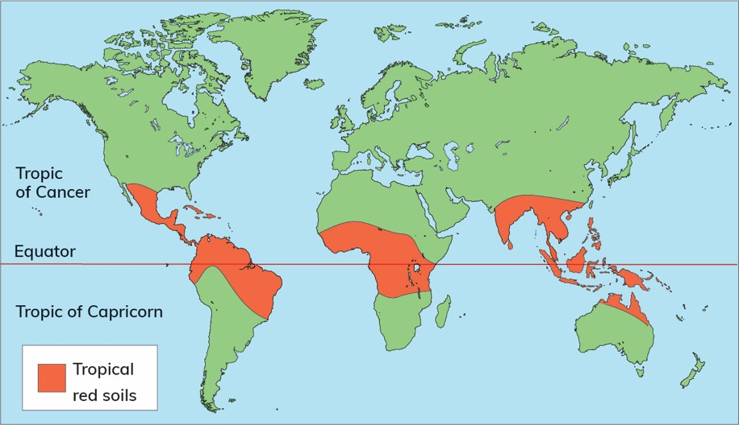
14.6 Describe the exploitation of soil as a natural resource.
Impact of Human Activity on Soils in Brazil
Tropical red soils are rusty-red in colour, and are very deep – between 20 and 30 m (whereas podzols are up to 2 m deep).
Tropical red soils are found close to the equator in places with a tropical or equatorial climate.
The hot, wet weather in these regions causes rapid chemical weathering.
Tropical red soils are common in Brazil.

Slide 44
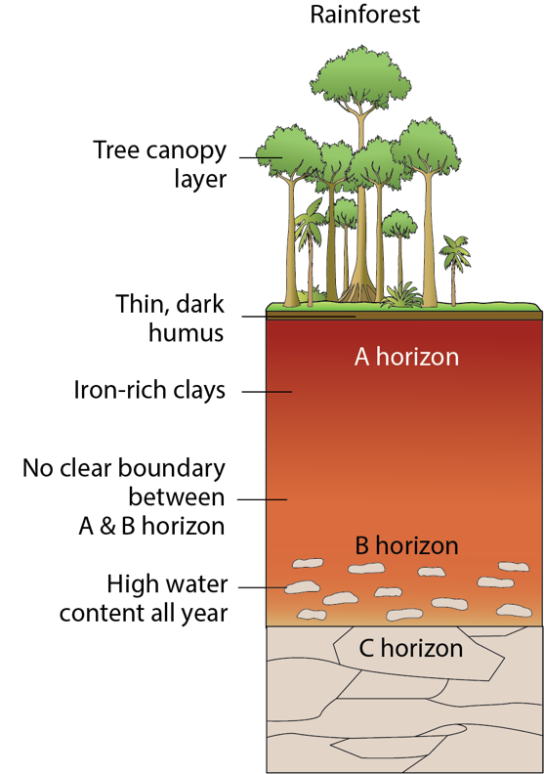
14.6 Describe the exploitation of soil as a natural resource.
Impact of Human Activity on Soils in Brazil
Formation of tropical red soils
1. The hot and humid climate causes intense chemical weathering, which breaks down rock. A deep soil horizon forms.
2. The parent material is red because it contains large quantities of iron oxide, which ‘rusts’ when weathered.
3. Tropical plants grow and produce a lot of plant litter.
High temperature and humidity causes rapid decay and produces a rich humus.
4. Leaching washes nutrients into the topsoil.
Rapid decay means the humus decays too quickly, however: only a thin upper layer of tropical red soils is fertile.
5. Tropical red soils are altered by human activity. Overgrazing exposes the soil, and the upper fertile layer is eroded. Over-farming leads to soil erosion.

Slide 45
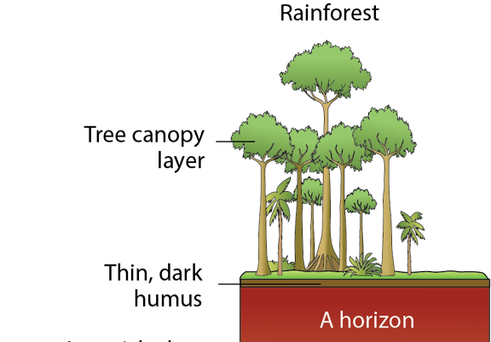
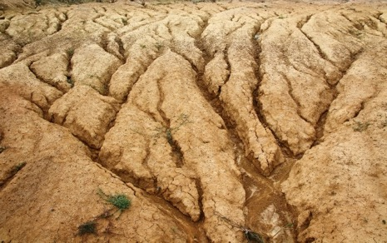
14.6 Describe the exploitation of soil as a natural resource.
Soil erosion in Brazil
Soil erosion is increasing as trees are felled for timber and mining.
Plant litter is no longer available to the soil. The humus layer is removed. The nutrient cycle is destroyed.
As the tree canopy layer is removed, the soil is baked and dried in the direct sunlight. Rainfall runs off this soil easily, as it cannot soak into the ground.
Deep grooves called gullies are cut into the soil by rainfall. Tree roots no longer hold the soil together. In upland areas, landslides and mudslides occur.
When land is cleared for farming, the rich plant litter of the tropical rainforest is replaced by grass for grazing cattle.
Grazing soon exhausts the soil. Once the soil is useless, farmers move on to clear new patches of rainforest.

Slide 46
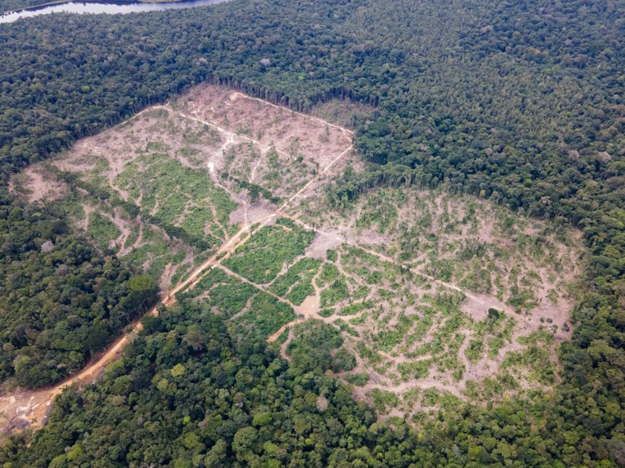
14.6 Describe the exploitation of soil as a natural resource.
Soil erosion in Brazil
An aerial photo showing deforestation and soil erosion in Brazil.
The dark-green areas are rainforest.
The light-green areas are where land has been cleared for farming.
The pale area is where soil erosion has occurred.

Slide 47
14.6 Describe the exploitation of soil as a natural resource.
The sustainable use of soil
We need to conserve (protect) soil so that it continues to meet our needs and the needs of future generations.
There are several simple steps we can take to protect soil.
Contour ploughing
Where land is steep, farmers can plough along a slope, instead of up and down the slope. This helps to stop water running down the slope and can prevent soil erosion.
Wind breaks
Farmers can plant trees around fields that act as a windbreak. This reduces the impact of wind on ploughed soil. It also protects crops and can increase how many crops a field produces. Small gaps are left between trees to prevent gusts occurring that could damage crops.
Crop rotation
Rotating which crops are grown in different fields can help retain a good balance of nutrients in a soil, e.g. growing barley in a field one year, and turnips the following year. This helps replenish (add back) nutrients to the soil.

Slide 48
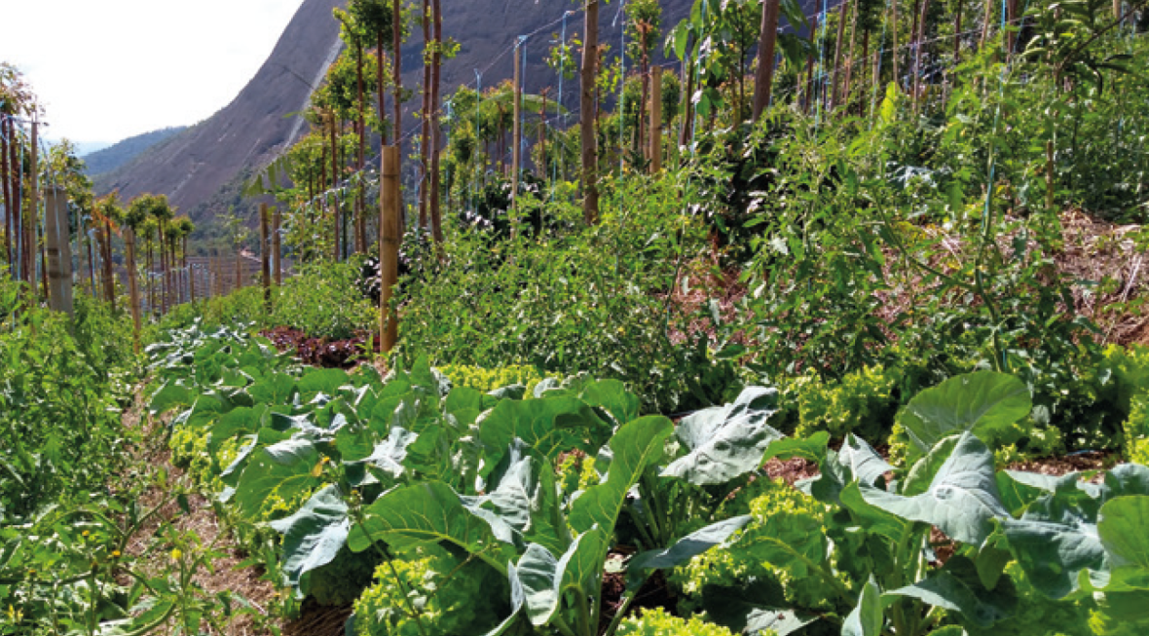
14.6 Describe the exploitation of soil as a natural resource.
Agroforestry
This is an approach to farming whereby, instead of removing trees, farmers maintain and/or plant trees as part of their farming activity.
Trees and shrubs can be grown alongside other crops or included in grazing livestock.
This helps conserve soil. It also increases the diversity of animal life.

Slide 49

14.6 Describe the exploitation of soil as a natural resource.
1. List five benefits of soil.
2. Identify four human impacts on soil.
3. Name three effects of desertification in the Sahel.
4. What is leaching?
5. Why is drainage important for soils?

Slide 50
14.6 Describe the exploitation of soil as a natural resource.
Higher-order questions 3
1. For this section of the course, you may have taken a soil sample so that you could learn about soils. What will you do with the soil sample when you are finished?
2. How many other ways can you think of to protect soil?
3. Is there are way to reverse desertification? Discuss how you might do this. Then research on the internet to see if any work is being done to reclaim land from deserts.

Slide 51
14.6 Describe the exploitation of soil as a natural resource.
Go to Section 14.6 on page 78 of your Skills Book.

Slide 52
Assess your progress
Go to page 82 of your Skills Book and assess your progress.
14.1 Describe the composition of soil.
14.2 Assess your soil type.
14.3 Explain how soil is formed.
14.4 Describe contrasting soils in Ireland soil.
14.5 Explain how soil and vegetation are interconnected.
14.6 Describe the exploitation of soil as a natural resource.
Identify any gaps in your learning. Use the Rapid Revision on page 179 of your Textbook to jog your memory.

